Slide 1
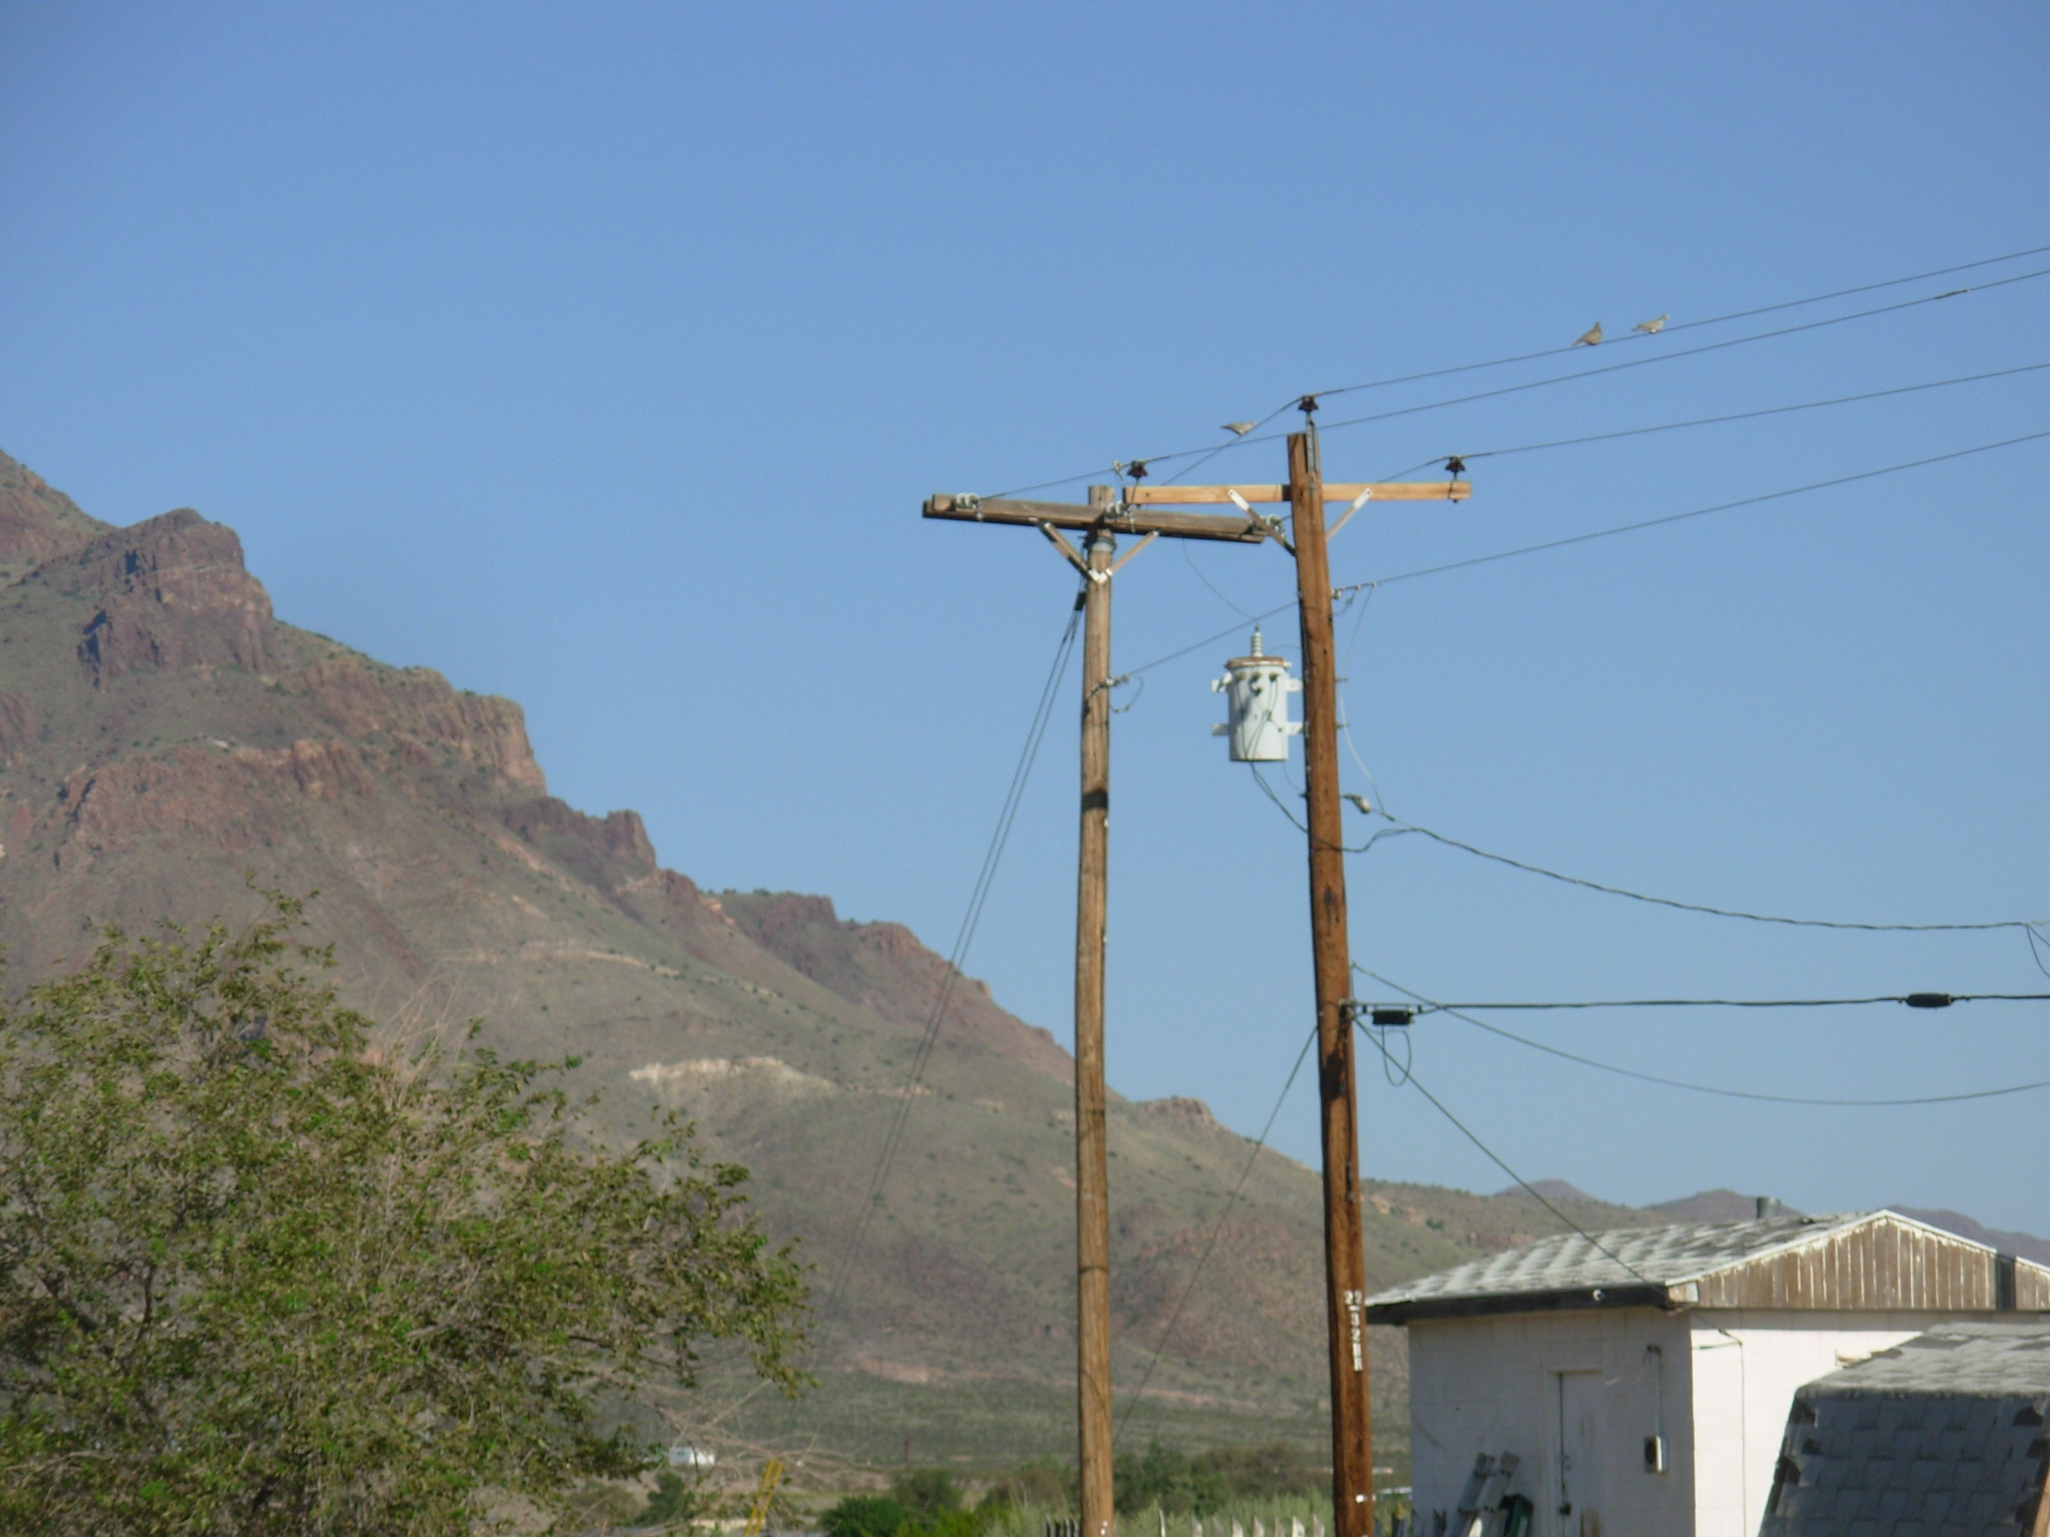
SOCORRO ELECTRIC SERVICE HISTORY

Slide 2
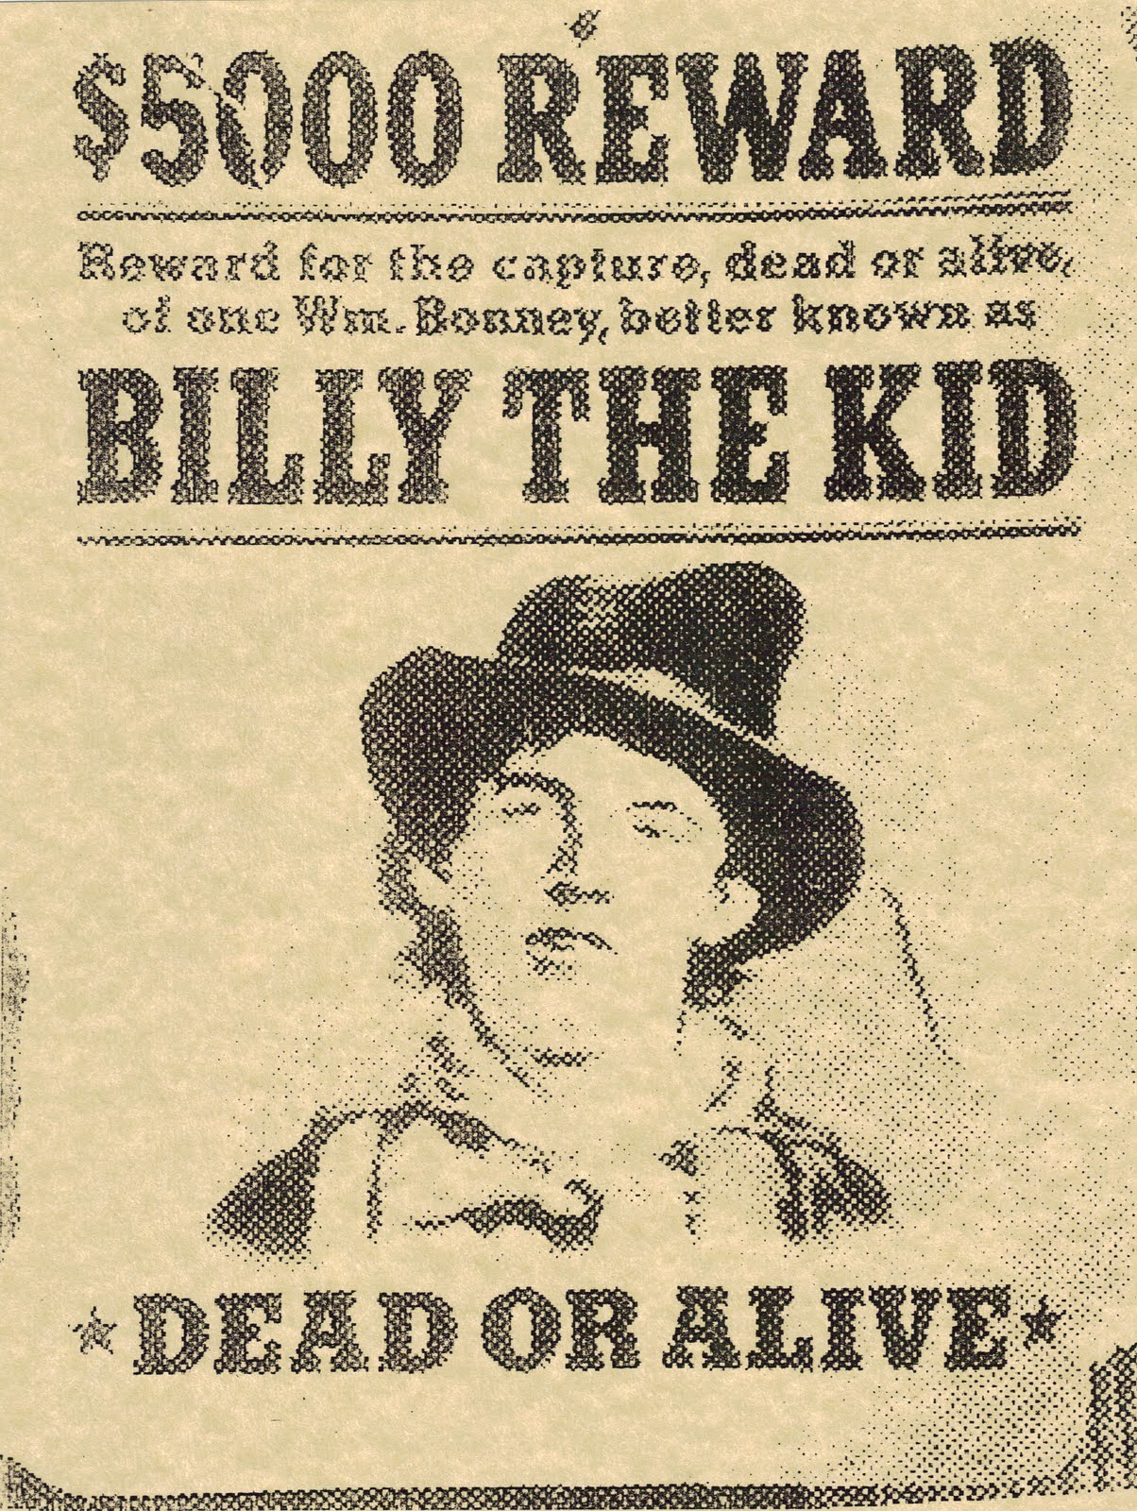
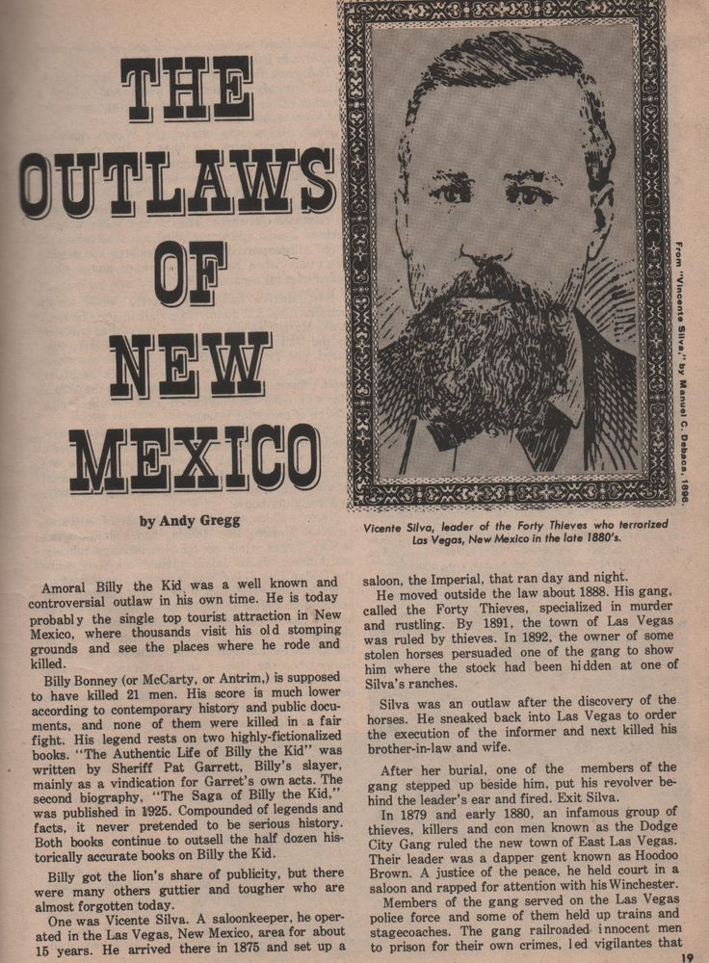
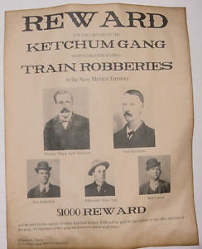
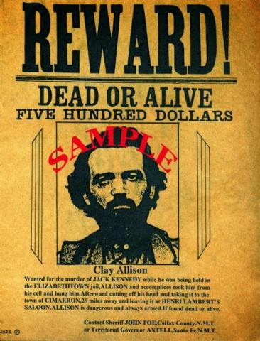
NM PATHWAY TO STATEHOOD
1850 – NM Territory
Billy the Kid
Clay Allison
Vicente Silva, and
“Black Jack” Ketchum

Slide 3
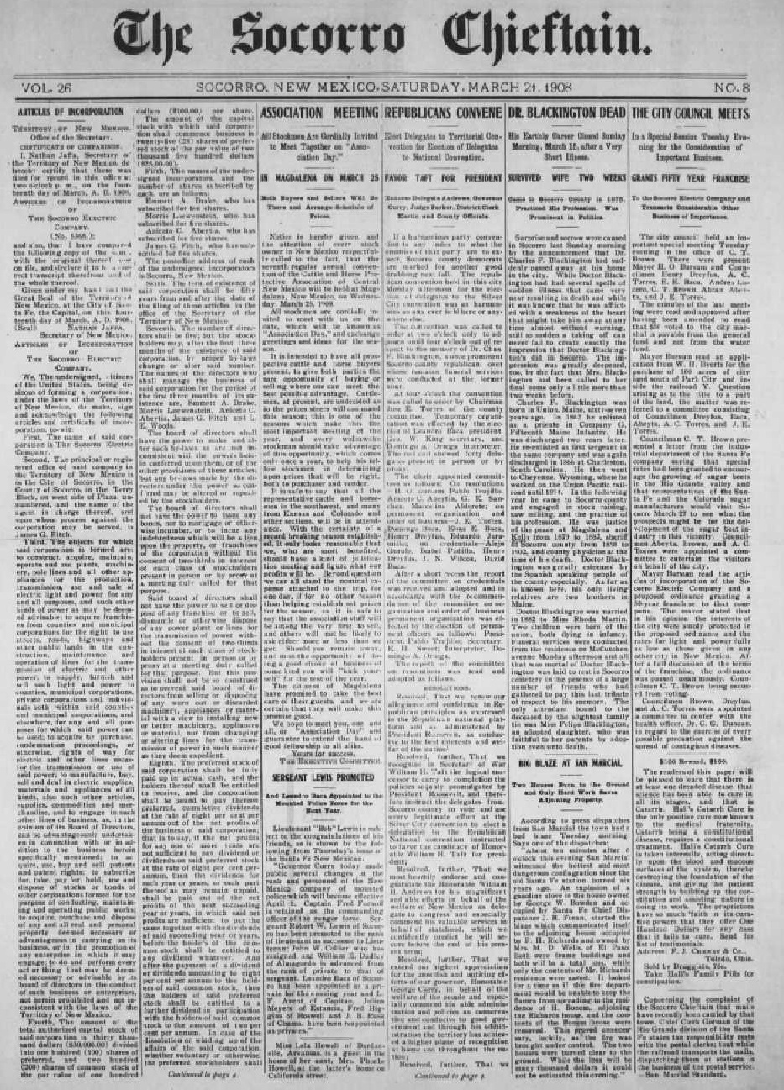
ELECTRIC SERVICE TO SOCORRO
March 14, 1908
Territory of New Mexico
Office of the Secretary
Certificate of Corporation
I, Nathan Jaffa, ,Sec. of the Territory of New Mexico, do hereby certify that there was filed for record in this office at 2:00 PM on the fourteenth day of March, A. D. 1908, Articles of Incorporation of the Socorro Electric Company (No.. 5368)
Dr. Woods of Chicago Led the effort to construct Socorro’s first power plant and distribution poles and wires for $20,000

Slide 4
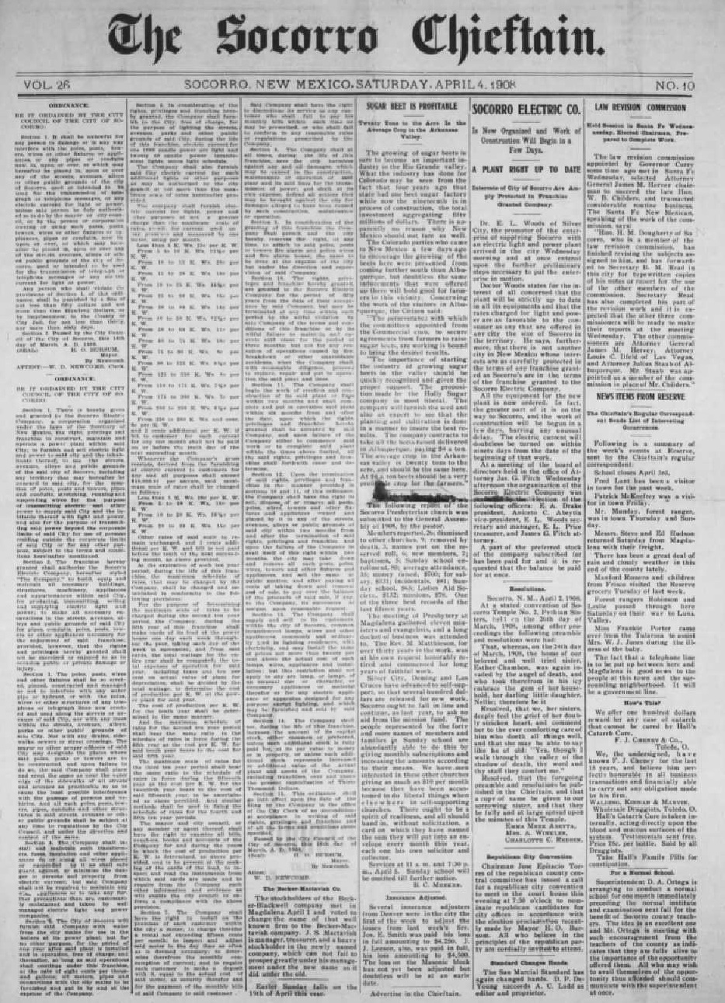
ELECTRIC SERVICE TO SOCORRO
March 16, 1908
“Be it ordained city Council of the City of Socorro:
Section 1. There is hereby given and granted to the Socorro Electric Company, a corporation organized under the laws of the territory of New Mexico, the right, privilege and franchise to construct, maintain and operated a Power Plant within said city:” … Passed by the City Council of the City of Socorro, this 16th day of March, A.D.1908 H.O. Bursum

Slide 5
1908 - 1944
NM Public Service Company

Slide 6
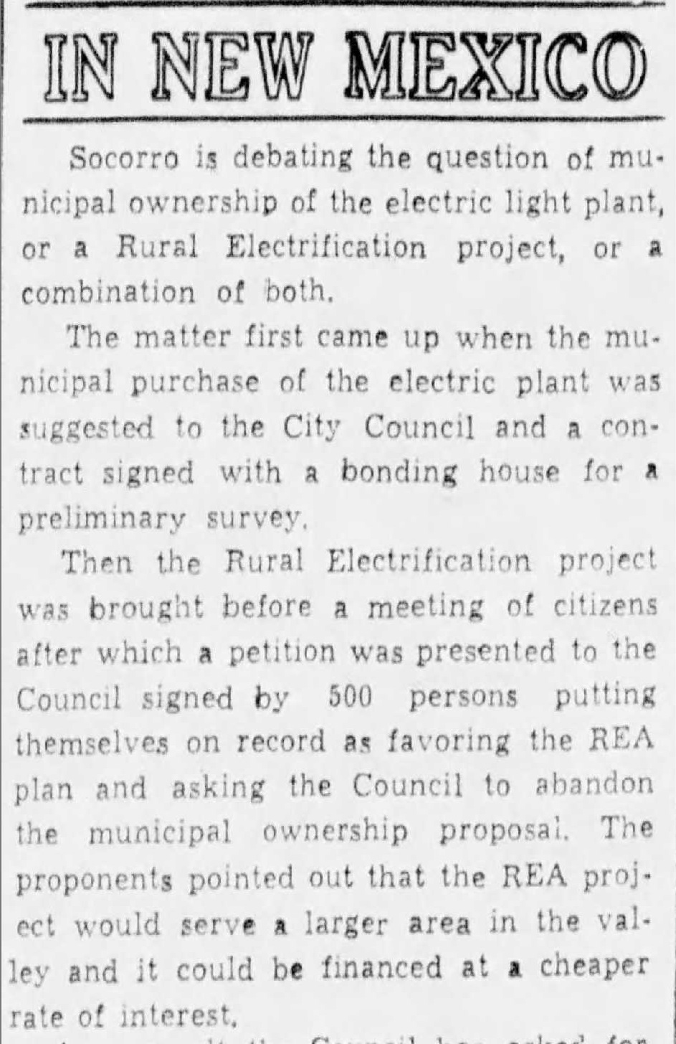
CITY OF SOCORRO PROPOSES TO PURCHASE THE SOCORRO POWER PLANT
December 1944
City of Socorro
Contemplates establishment of municipal power utility

Slide 7
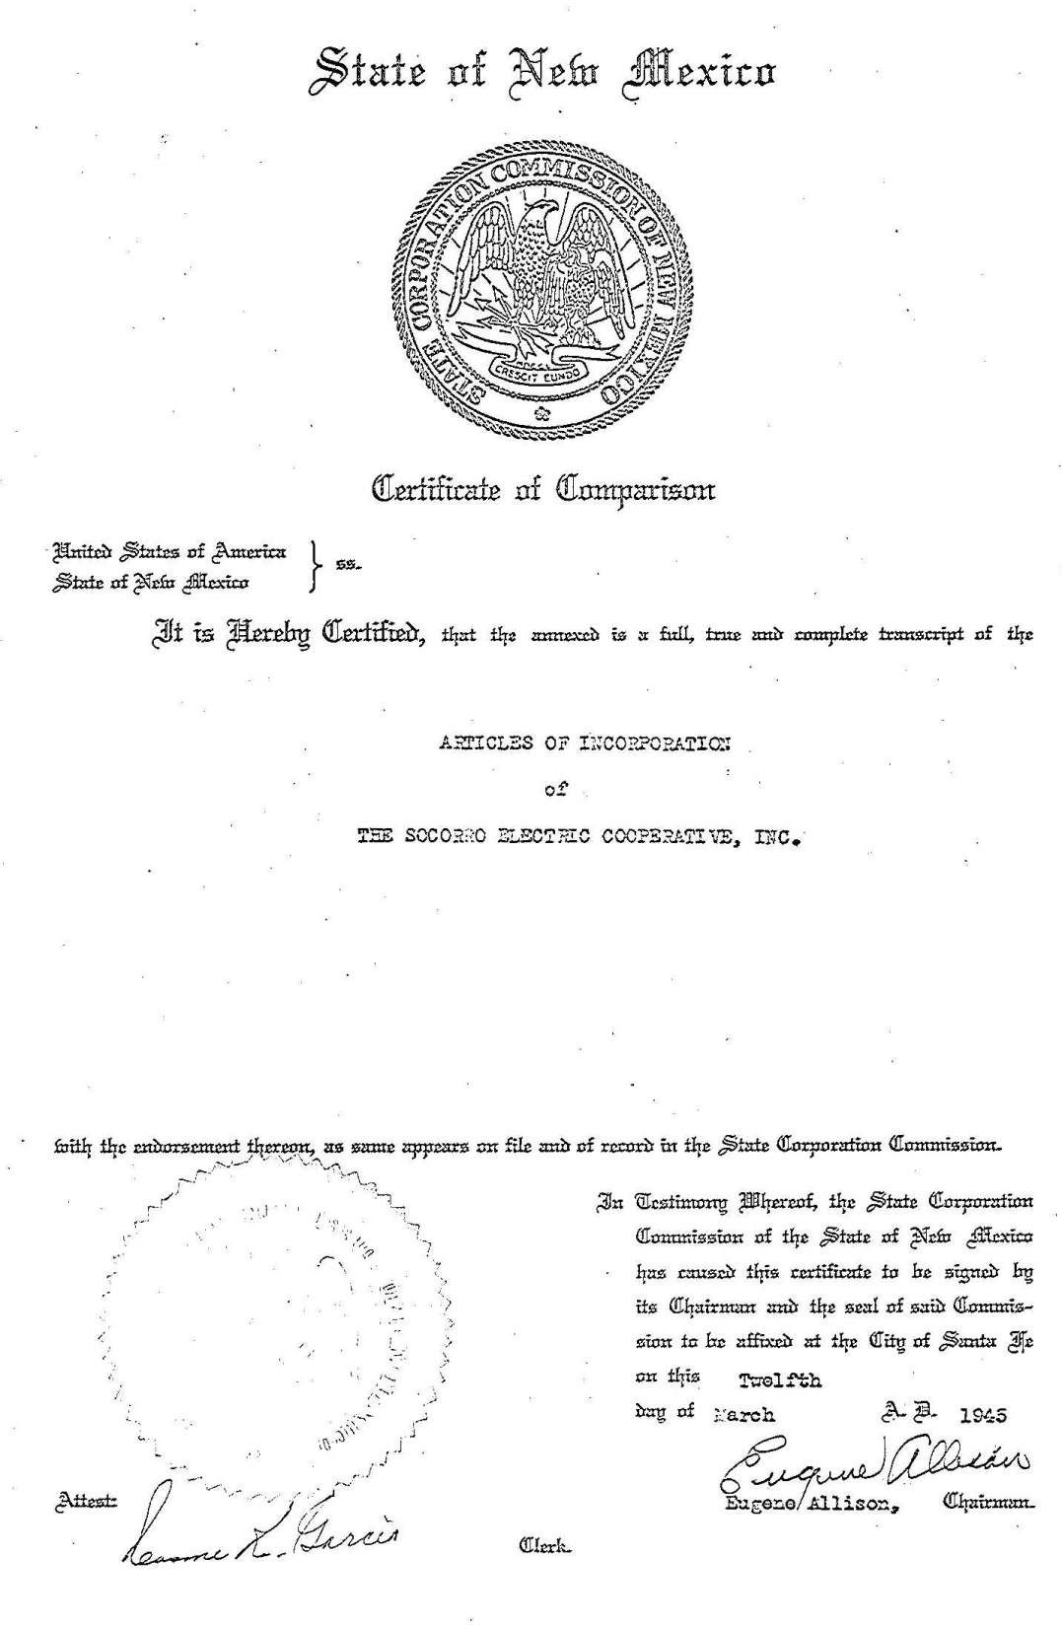
SOCORRO ELECTRTIC COOP

Slide 8
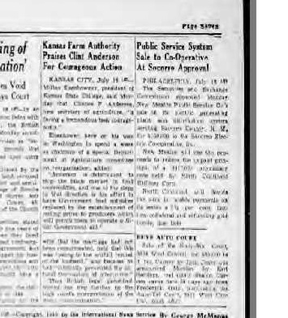
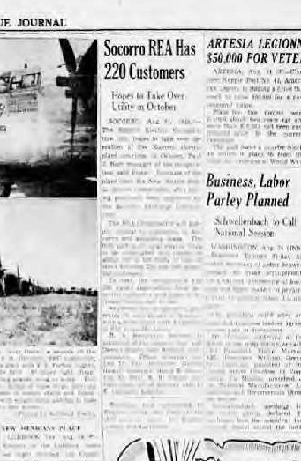
ELECTRIC SERVICE TO SOCORRO
1945
August 1945
The sale of the New Mexico Public Service Company’s generation and distribution facilities in Socorro County was approved in July 1945 by the Securities and Exchange Commission to the Socorro Electric Cooperative for $160,000

Slide 9
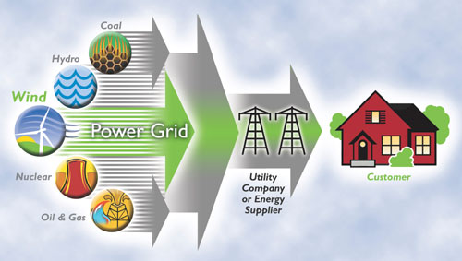
ELECTRIC ENERGY’s FUTURE

